Slide 1
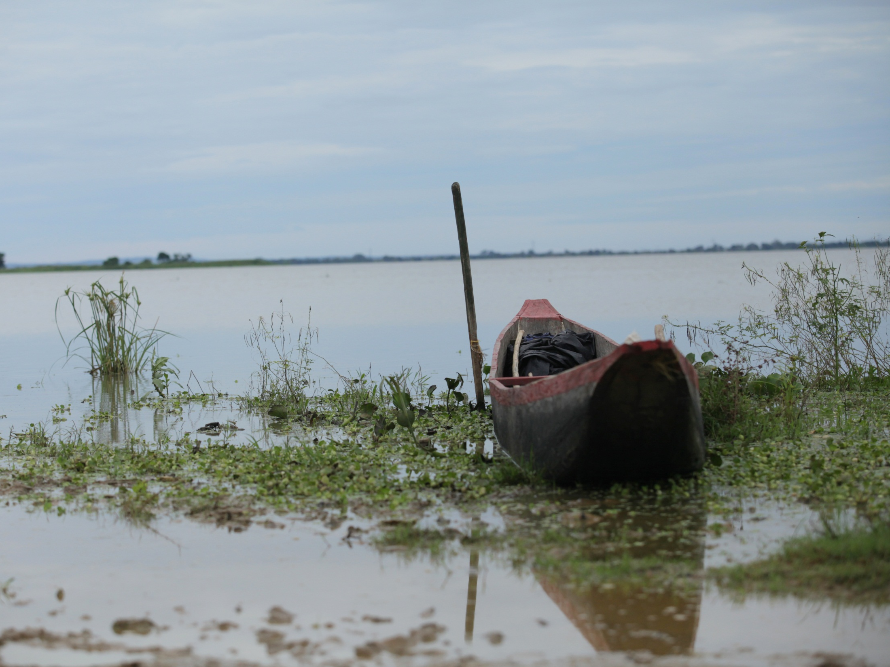

Magdalena River Basin
Working Together towards Whole-River Solutions
Healthy Waters

Slide 2
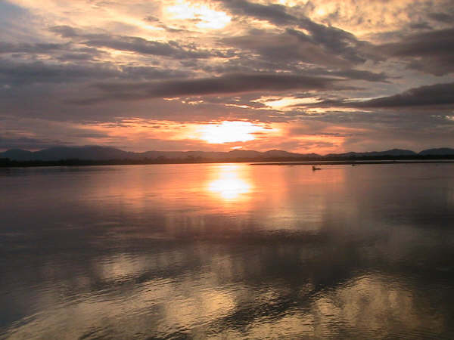
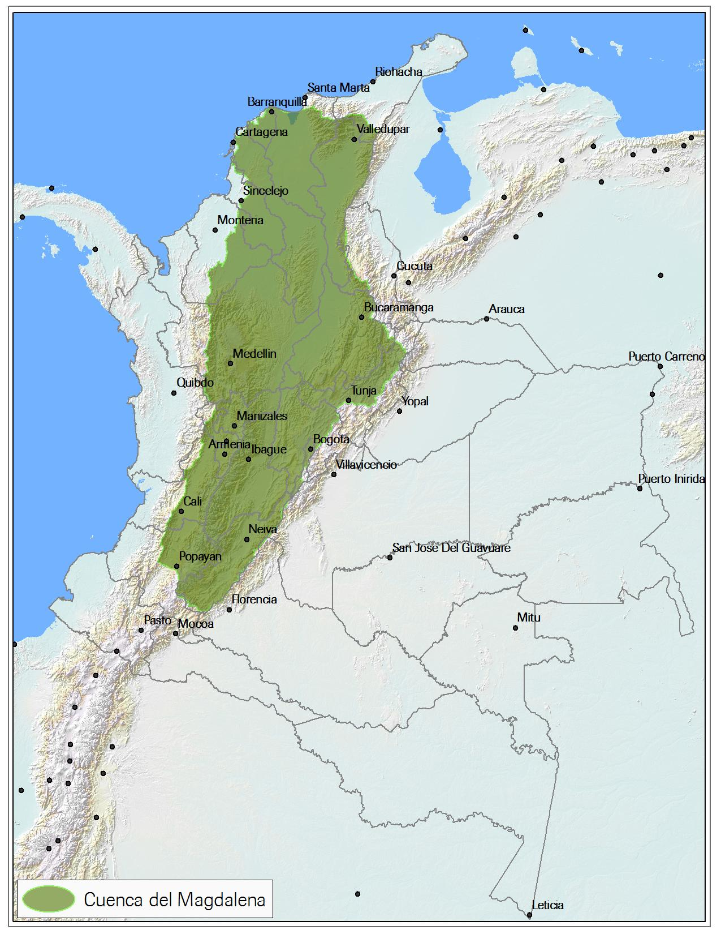
Notes:
As many of you already know, the Magdalena River is the most important river in Colombia. Is located in the northwestern part of Colombia, and is almost a fourth of the Colombian territory. The Magdalena river basin which covers 274,000 km², almost a fourth of the Colombian territory
950 miles - length
As much as 80% of the entire population of Colombia lives in the Magdalena watershed, which includes its four main cities (Bogotá, Medellin, Cali, and Barranquilla).

Slide 3
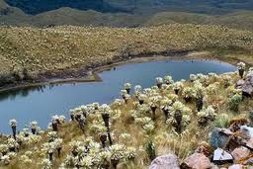
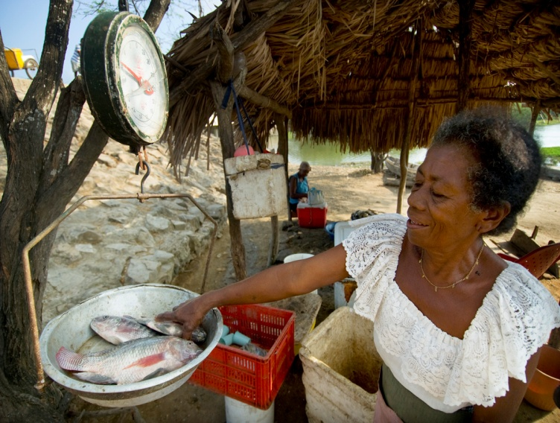
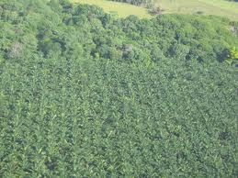
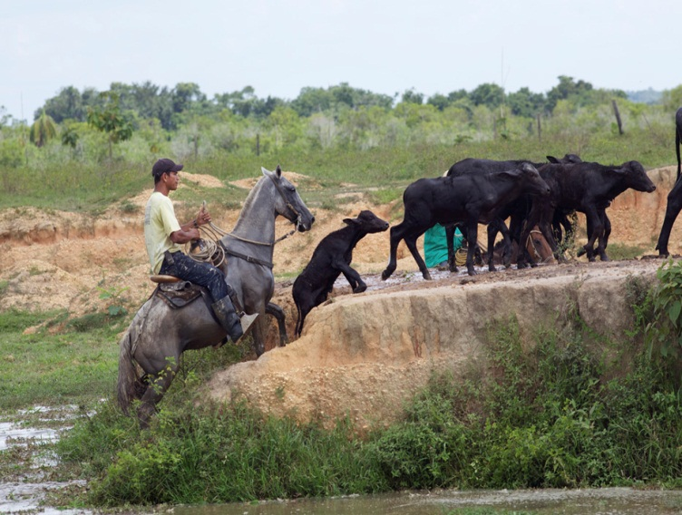
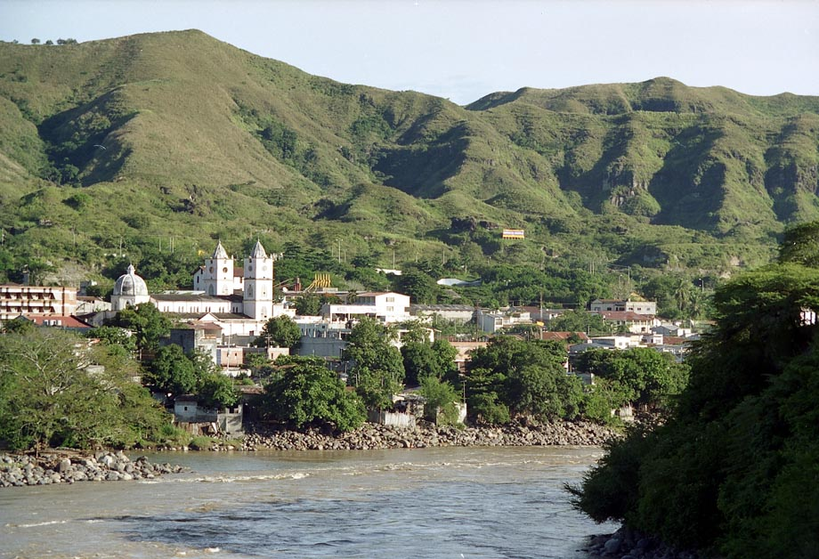
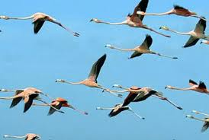
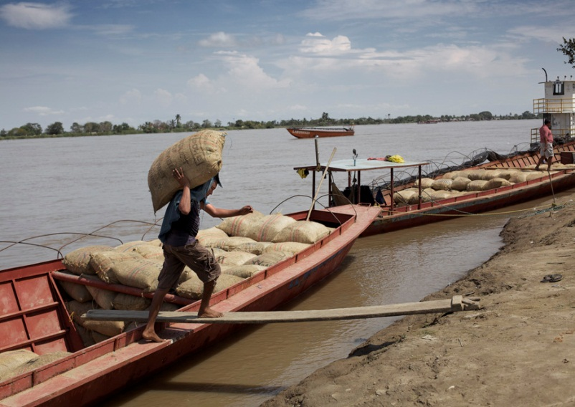
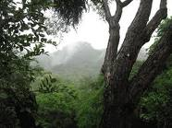
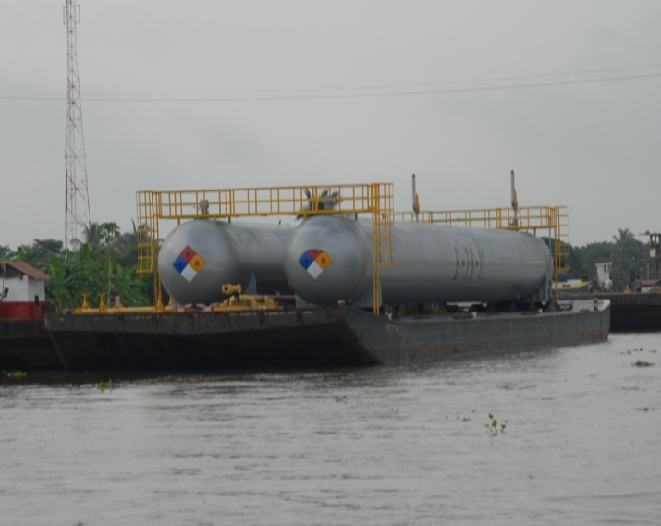
80% of the GDP.
Water for 30 million people.
75% of the agricultural production.
90% of coffee production.
70% hydropower.
Majority of the ecosystems of the region.
250 species of fish; 50% endemic.
800 species of birds; 183 migrants.
Notes:
The Magdalena supports some of the most diverse, productive and beautiful ecosystems in South America, harboring an incredible diversity of species. The basin also supports 80% of Colombia’s people and economic activity, including the country’s most important freshwater fish harvest.
CLICK
Beyond its natural and economic importance, the Magdalena is the cultural heart of Colombia, woven into its history and culture.
But much like the Yangtze, Mississippi and other great rivers, the Magdalena’s vitality is now jeopardized by the many many demands placed upon it.
The basin produces 8o% of the gross domestic product (GDP), generates 75% of the country’s agricultural production, produces 70% of the country’s hydraulic energy and 90% of its thermo-electric power, and produces more than 90% of the country’s coffee.

Slide 4
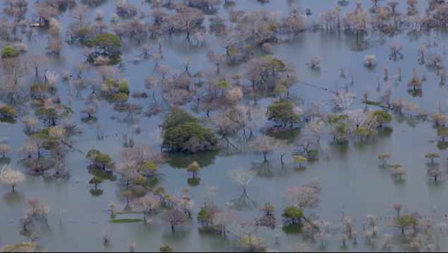
The Problems
Fragmented planning, decision making and management without an integrated vision.
Unsustainable practices.
Vulnerable to extreme hydrologic events- Climate change.
Notes:
The Magdalena is a large river basin confronting diverse pressures. A primary constraint for effective basin-scale management and decision making is that the basin suffers from fragmented authority, inadequate institutional coordination and a limited availability of information, data and tools. For example, the Magdalena basin encompasses 128 municipalities, 13 States, each with its own regional environmental agency (CARS), and an overarching basin-wide environmental agency, known as Cormagdalena.
- Unsustainable practices, such as agriculture, cattle, dams. Their planning process don’t take into account environmental criteria, for example environmental flows. For example, 42 major hydropower dams have been proposed for the river. Poorly planned projects threaten to erode the Magdalena’s ability to provide its full spectrum of benefits, such as productive fisheries. In fact, the annual fish harvest decreased by 80 percent over the past 15 years.
- Besides economic pressures, the basin is highly vulnerable to extreme hydrologic events; the last (2010-2011) flooding event affected more than 2.2 million people, destroyed 280,000 homes, and generated economic losses estimated at 2% of Colombia’s GDP. Other economic and social infrastructure has also been damaged. Over the period of 1970-2007, the majority of natural disasters (nearly 80%) are linked to hydrology, including landslides, storms, floods and droughts). All of these types of disasters can be exacerbated by climate change.

Slide 5
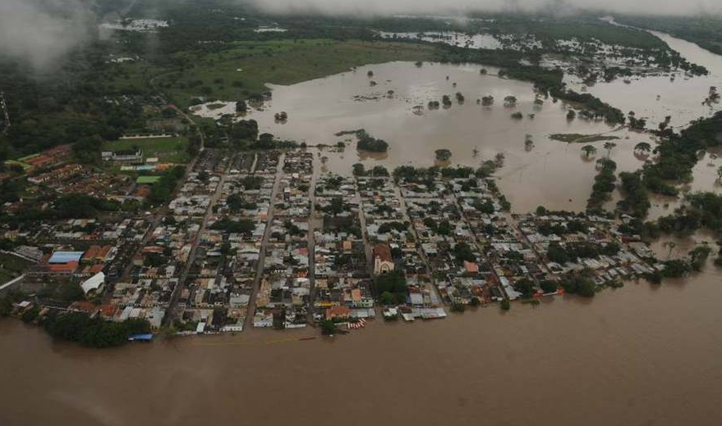
Vision → Integrated River Basin Management reduces climate risk, and preserves nature and ecosystem services for 35 million people
Outcome → National government and local stakeholders adopt EBA and green infrastructure approaches as part of Integrated River Basin Management strategy
Notes:
Consequently, it is crucial to develop adaptation and management strategies to increase the adaptation capacity of human populations and the biodiversity in the Basin.
Inspirational Vision
TNC will collaborate with the Colombian government, communities, and other partners to promote IRBM for the Magdalena River. By coordinating across various sectors and embedding sustainable management of environmental resources throughout planning, decision-making and implementation, the Magdalena’s freshwater systems will continue to provide a broad range of important services and benefits to the 35 million people that live within the basin.
Outcomes–
- National government and local stakeholders adopt EBA and green infrastructure approaches as part of an IRBM strategy into policies and management plans in order to prevent socioeconomic losses caused by flooding and drought, and to maintain a resilient river ecosystem

Slide 6
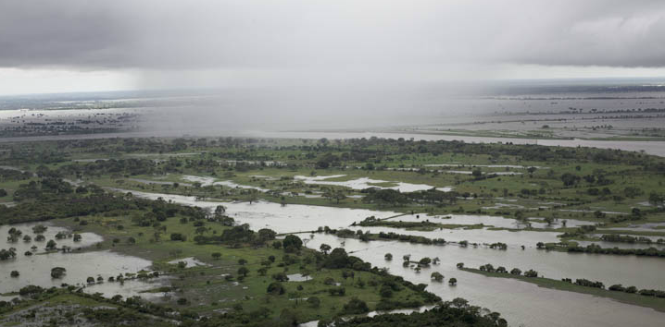


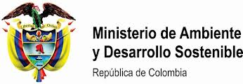



Most important audiences
National
Regional
Local
Notes:
OJO: Mencionar rapidamente ppls procesos q apoyamos o buscamos incidir: MADS (plan estratégico), FA (Dique), ANLA (licencias), Cormagd (Plan maestro), IAvH + IDEAM National Institute of Hydrology, Meteorology and Environmental Studies (IDEAM). : Delim humedales
National: DNP (National Plan of Adaptation to Climate Change), Parques Nal, Humboldt
Regional: Gobs, Munc, CARs,
After the last extreme flooding events (2010-2011), the government created an Adaptation Fund, of which 80% (or 11.5 billion euros) is allocated for rebuilding damaged roads, schools, public buildings and other infrastructure as well as short-term, traditionally engineered flood management solutions, without considering more integrated, cost-effective, long-term solutions, including floodplain- and ecosystem-based adaptation strategies.

Slide 7
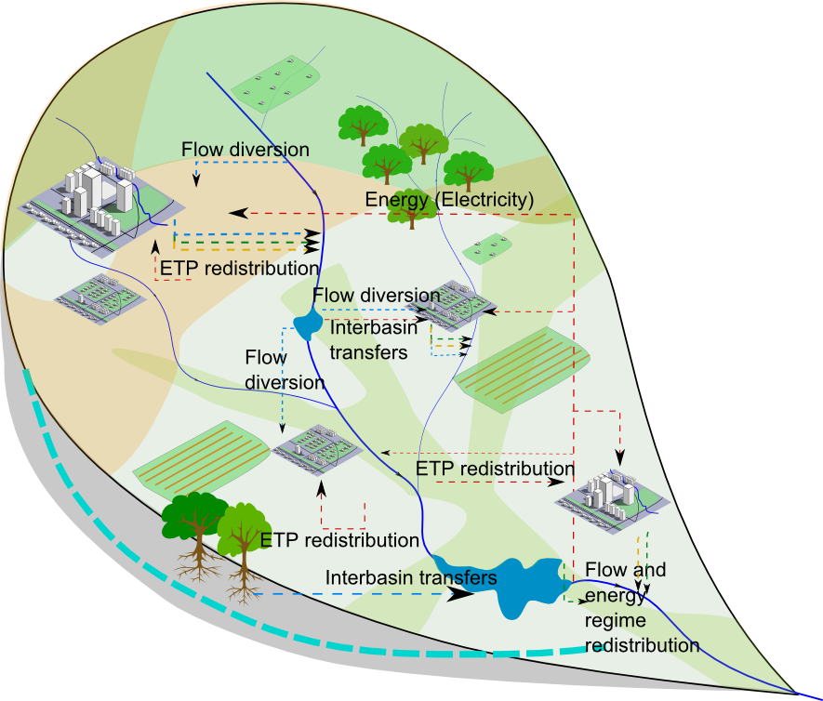
INFORM:
Hydrologic model of the Magdalena River Basin (WEAP)
P: Precipitation
Et: Evapotranspiration
Infiltration/
Percolation
ETP
Soil
moisture
Q: Discharge
Baseflow
Notes:
For the Magdalena River basin, we are developing a hydrologic model which allow us to represent the water balance of the basin considering different human alterations.
To build it, we used more than 250 flow gauges (geyyes) and more than 1000 climate stations from the Hydrologic and Metereologic National Authority, and official data for land cover and land use. We include the present and projected hydropower infrastructure and we will be continue adding different productive sectors as irrigation.
This model also allow us to simulate hydrologic responses under climate change scenarios (derived from climate-wizard as Evan show us yesterday), and also other expected changes as demographic trends or water efficiency consumption.

Slide 8
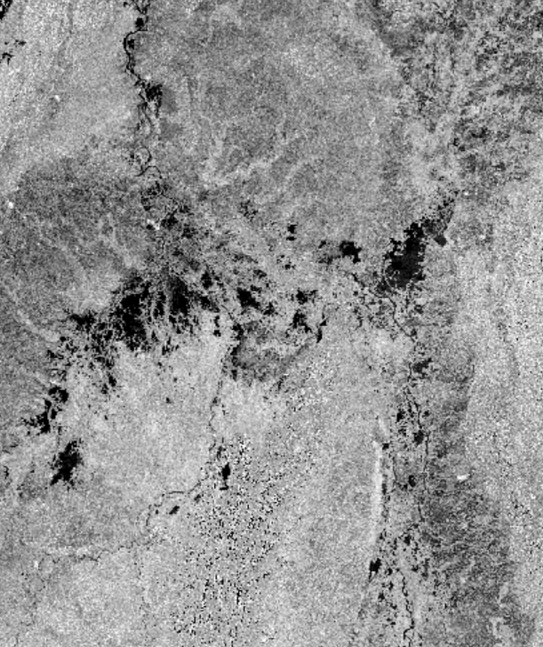
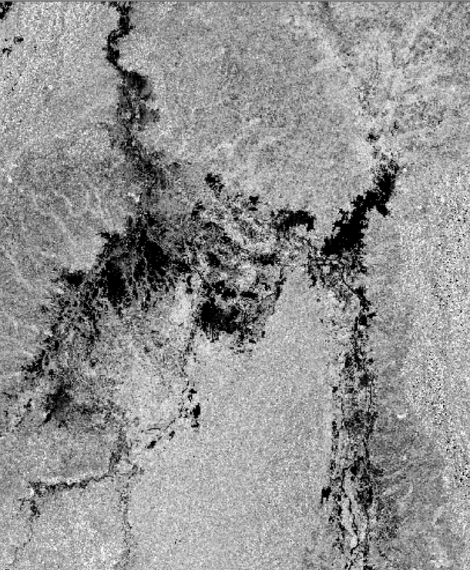
Dry season
Wet season
La Mojana Region (2007 – 2010)
Notes:
We are improving this model with the development of new data sets, such as the one derived from radar imagery analysis. I am showing here two images for dry and wet season for the Mojana region (an inside delta of the Magdalena River). With partners, we processed a period between 2007 and 2010 for the whole Basin.

Slide 9
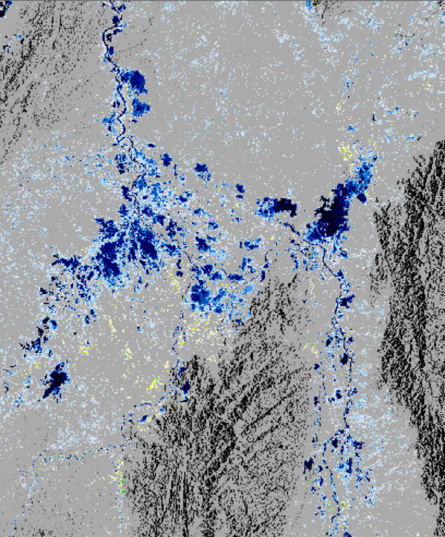
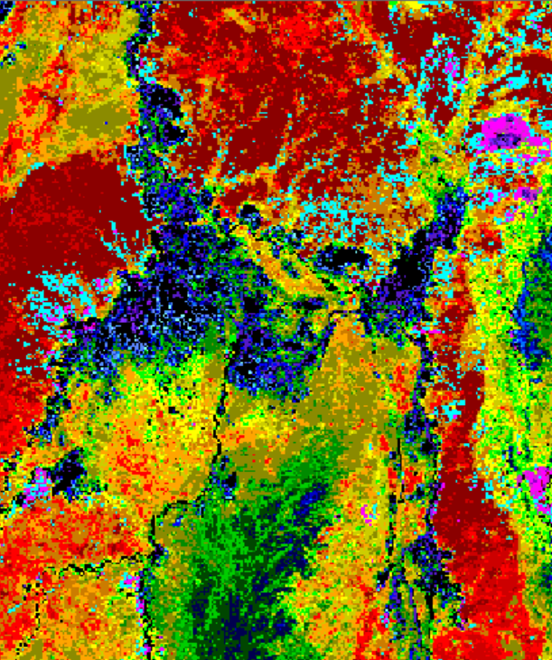
Flood frequency map
Vegetation type map
La Mojana Region (2007 – 2010)
Notes:
And the results are a sequence of images showing the Flood pulse for the Magdalena and a flood frequency map, as well as a Vegetation type map. With this we are supporting the actual government process for delimitation of wetlands in the country.

Slide 10
ENABLE:
Decision-Making Support System build with key stakeholders
Hydrologic & Sediment Modeling (WEAP)
Terrain Variables
Development scenarios for:
Hydropower
Agriculture and Cattle Ranching
Navigation and other water users
Climate change scenarios
Fresh Water Conservation Portfolio
Environmental Flows (ELOHA)
Climate Change and climate variability adaptation scenarios
ANLA
Cormagdalena
CARs
Freshwater and ecosystem services Off-set scheme
MADS
IDEAM
Other…
Notes:
Enable: construir la herramienta con los actores claves (ideam, anla y cars) para definir con ellos los alcances e identificar las limitaciones
Y entender las necesidades
MENCIONAR ACUERDOS
To specifically address the impacts of large infrastructure projects on hydrological alternations in the watershed and to provide decision making information, for example, in the operation of dams, TNC, in cooperation with MADS, initiated a study through the application of the logical framework “Ecological Limits of Hydrological Alterations – ELOHA.” This tool can produce biological flow maps for the entire Basin but also can be downscaled for a particular region to improve dam operation. Currently, the tool has only been run at a very large scale with hydrological and biological data and there is a need to further refine the scale of this and other hydrological tools so as to provide more useful information to local and basin level decision makers, particularly for the four project sites.

Slide 11
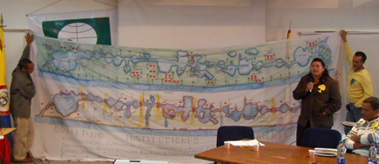
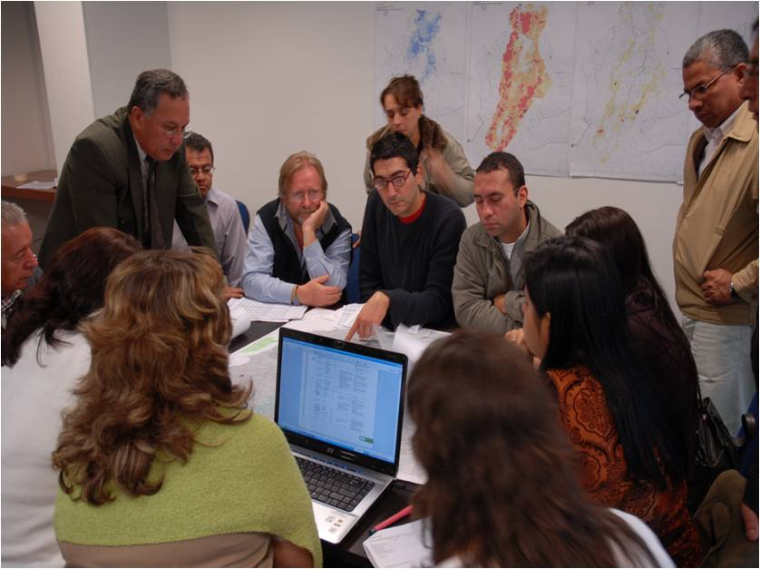
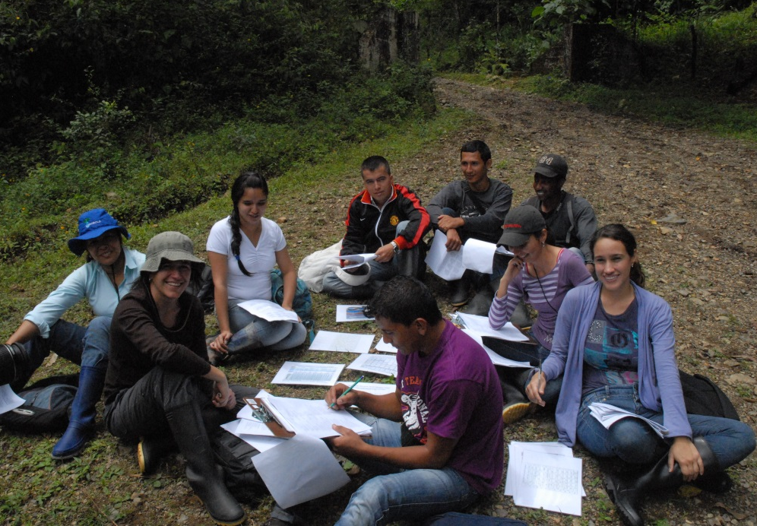
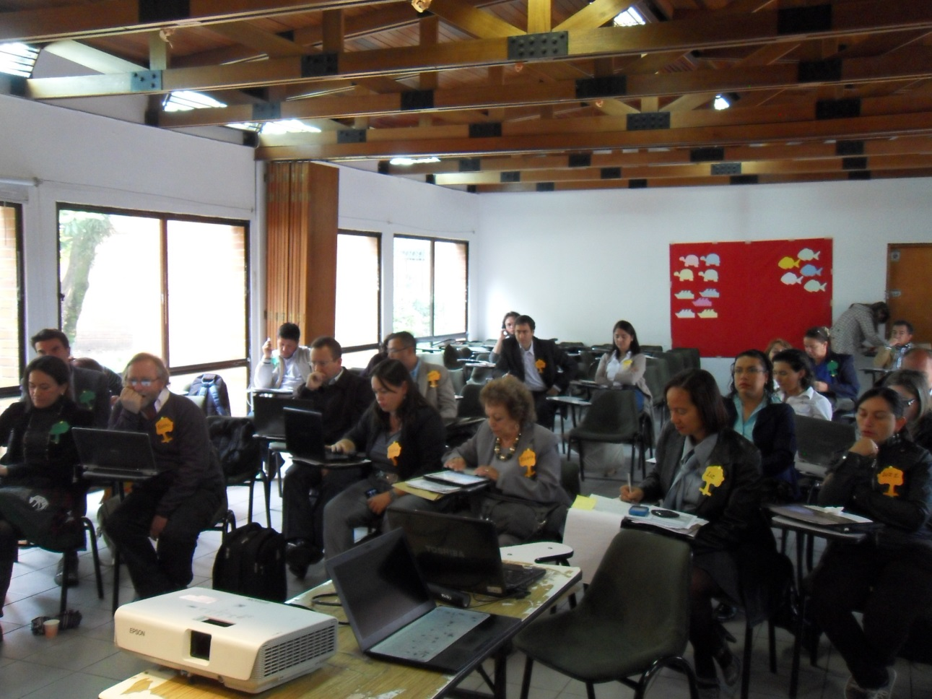
INCENTIVIZE:
Decision-Making Support System included as a guideline in different planning instruments and policies
Notes:
** We are promoting Policies + related regulatins → to motivate the adoption and efective use of the DSS to management the basin
Incentivize: que se defina como lineamiento en los instrumentos de gestión: Apoyando el proceso de la construcción de los Lineamientos Estrategicos de la Macrocuenca, para asegurar que se incluya la necesidad de contar con esta herramienta para la gestión integral de la cuenca y oriente la toma de decisiones
- Lineamientos estratégicos
Plan Maestro
National Plan of adaptation to climate change
Mesa Humedaes interiores
Delimitacion de humedales
Offsets, e-flows
GEF → Government structure and staff is constantly changing in Colombia.
Given the increasing concern over the impact of dams and climate change on resources and biodiversity in the Magdalena basin, there are several initiatives aimed at improving the understanding of the basin, from ecosystem characterization to basin wide modeling, that will provide baseline information necessary for the correct use of these tools. For example, as part of IDEAM’s development of climate scenarios and flow dynamic models, and in an effort to improve data availability in the basin, it has allocated Adaptation Fund resources (US$28 million) to invest heavily in expanding and refurbishing its system of monitoring stations. On the other hand, CORMAGDALENA will be developing a hydrological model of the Magdalena River and its connectivity with wetland systems. The IDEAM and CORMAGDALENA baseline projects will contribute US$ 3 and US$ 2 million, respectively, towards project cofinancing.

Slide 12
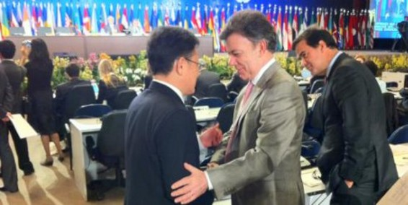
Río +20
LEAD:
Magdalena River Basin: A national priority
http://www.youtube.com/watch?v=XtbZGVriGcM
Notes:
Foto Presidente at Rio + 20, wher he made the integrated managmente of the Magd Basin an international commitment. This coomitent is also included in the national development plan. Consequently, the national agencies are leading new interinstitutional arrangment and processes in order to define a unified vision for the development and managment oof the basin.
Environmental council for the Magdalena Basin.

Slide 13
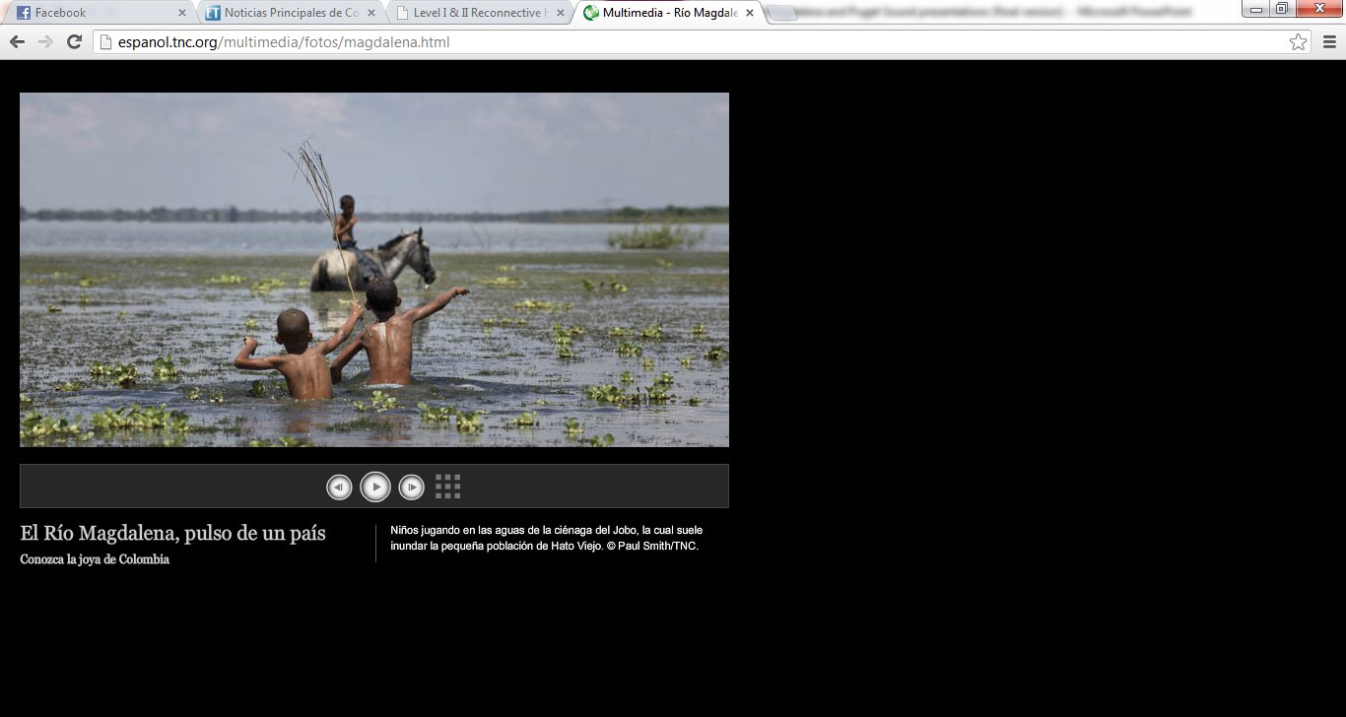
Good practices to success ….
Working with key audience (national/regional/local) from the very beginning.
Identify the key audience and processes that could help us to accomplish our outcomes efficiently.
Choose few messages and present them consistently and persistently.
Keep an open communication and provide support to their processes and interests.
Identify and promote long term mechanisms to enable the continuity of the process despite possible changes.
Notes:
Working with key audience for the very beginning at different spatial scale: Focus on the needs that the key audience have and show the information in the way they required. Choose few messages and presented them consistently and persistently.
Keep an open communication and provide support to their processes and interests.
Identify the key audience and processes that could help us to accomplish our outcomes efficiently.
Identify and promote long term mechanisms to enable the continuity of the process despite possible changes.

Slide 14
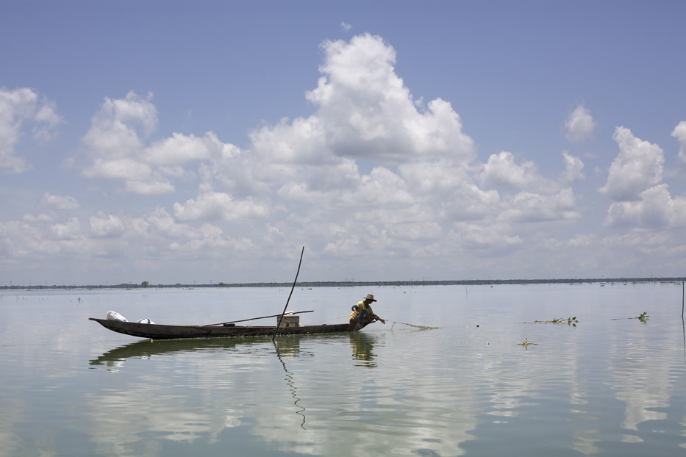
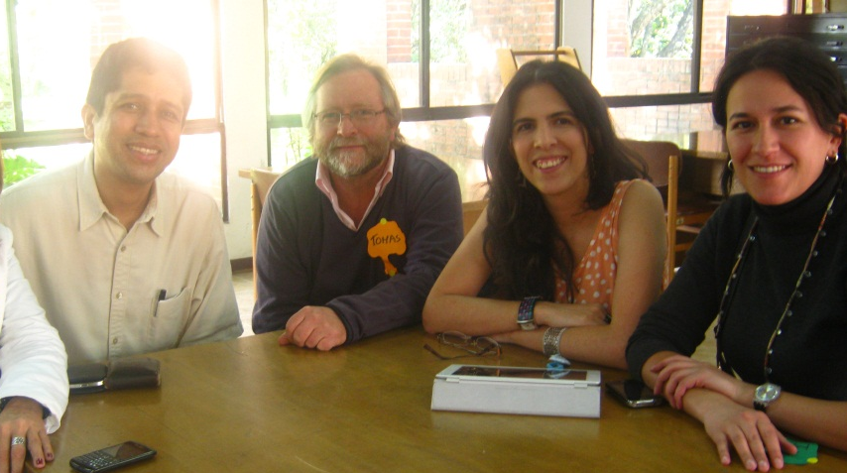
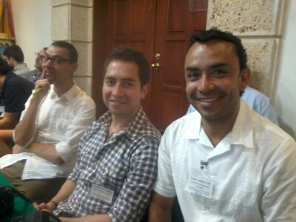
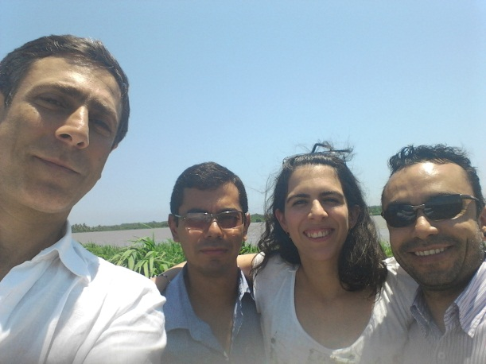
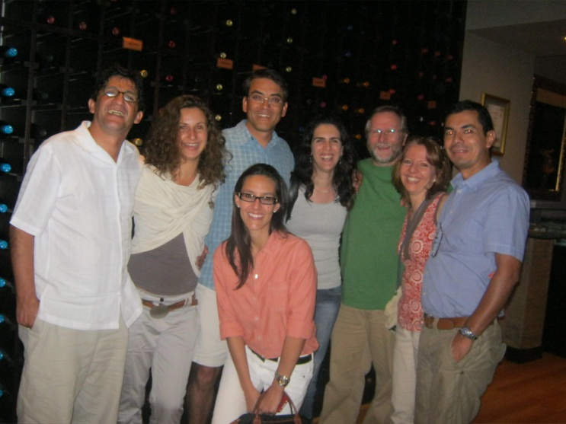


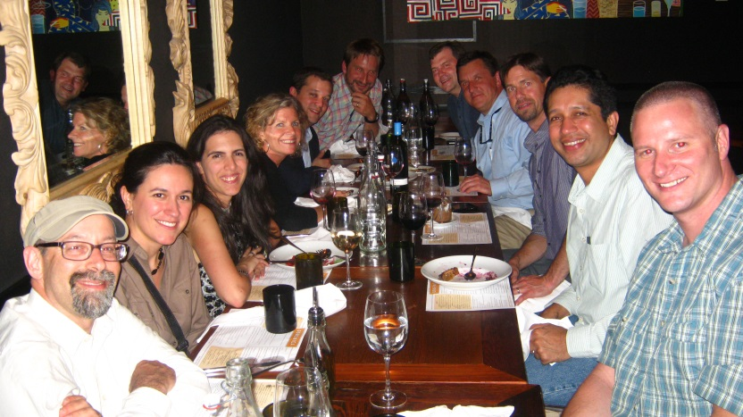
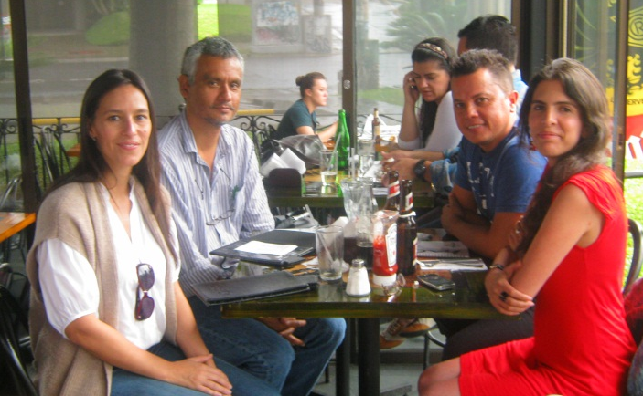

Slide 15

THANK YOU!!!!
Notes:
I invite you to visit the basin, Colombia and Latin America.
More than happy to answer any question. Thanks a lot.

