Slide 1
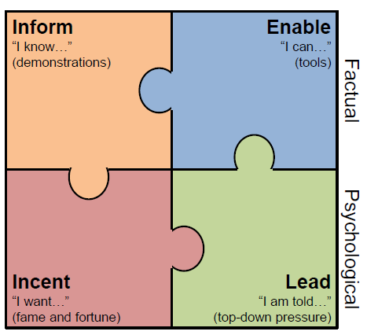
Our theory of change – how to scale through others
All four need to be in place to make change happen

Slide 2
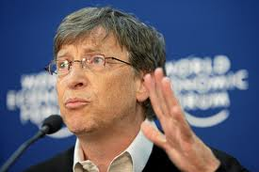
An example from health systems
Inform
“I know…”
Enable
“I can…”
Incent
“I want…”
Lead
“I am told…”
PERFORMANCE BASED FUNDING
28.3 Bn $
PROCUREMENT & SUPPLY
MONITORING AND EVALUATION
Independent technical committee and local partners

Slide 3
An example of a program for Hydro/infrastructure siting
PRELIMINARY
ILLUSTRATIVE
Inform
“I know…”
Enable
“I can…”
Incent
“I want…”
Lead
“I am told…”
Work with partners to codify and establish economics, and technical best practices for hydropower siting and design (1 FTE + 1 consulting contract per year on economic analysis/retrospective analysis for 3-5 months
Establish and analyze target audience for influence, determine channels and appropriate models for information transfer: first year audience segmentation etc followed by data/statistics/survey every year for the program to track penetration
Design program of education/information for target audience – Content creation (graphics, editing, translating); printing dissemination, marketing, PR, online; academic events, training courses (including fees for trainers)
Establish technical exchanges and targeted support on hydro – 1 PM/RM with Sinhydro, Odebrecht et al
Identify commercial and non commercial partners for tool development, and develop tools to be used in GRP basins and elsewhere for siting, economic analysis, technical analyze
Execute on dissemination of tools and enablers – contract with 2-3 engineering firms to test/develop software in real projects alongside existing tools
Create global platform, leverage existing events, to drive a community around hydro sustainability, targeting commercial industry and public sector – Speaker events, catering, organization + 1 project manager
Establish high level training in hydro design issues with prestigious institutions – organize workshops (travel, rental, payment for research associates for 3 1-week workshops)
Create/build on industry alliances on hydro to promote the adoption of sophisticated practices on sustainable hydro.
Recruit global leadership council with peers of key decision makers we are trying to influence (1 PM/analyst)
Provide secretariat to leadership council group to deliver connections in the industry, mobilize their networks (PM + 1 analyst)
Use leadership and board networks of GRP organisations to explore opportunity/potential for engagement in upper Mekong – PM + Consulting contracts
Focus on 8 GRP rivers accounts for 12-15% of total potential hydro build out
Sinohydro and Odebrecht will deliver the majority of the new build
A focused program on developers and EPC contracts, alongside targeted government counterparties would leverage the smallest number of people with the highest potential for impact

Slide 4
To achieve scale we will have to implement through others, influencing their activities through a coordinated program
Elements of a program of work to have impact through others
Pilots, demonstration projects, research
Requires extracting, collecting, curating, delivering relevant knowledge to target audience
Not enough to simply codify experience – knowledge must be received, understood
Inform
“I know…”
Enable
“I can…”
Tools, platforms, instruments, instruction to make it as easy as possible
Best to modify existing tools that are already adopted than creating new ones
Might require partnership with commercial providers
Create soft & hard incentives for adoption
Common approaches include prizes, visible international platforms, rewards
Adoption must be desirable to succeed
Leadership and role modeling are critical to change in behavior
Enlist leaders and key influencers to legitimize change
Create or adopt a platform for leaders to endorse/exhibit new behavior
Incent
“I want…”
Lead
“I am told…”
Focused on a set of partners and/or audience that, if appropriately influenced, can implement a specific solution at scale

