Slide 1
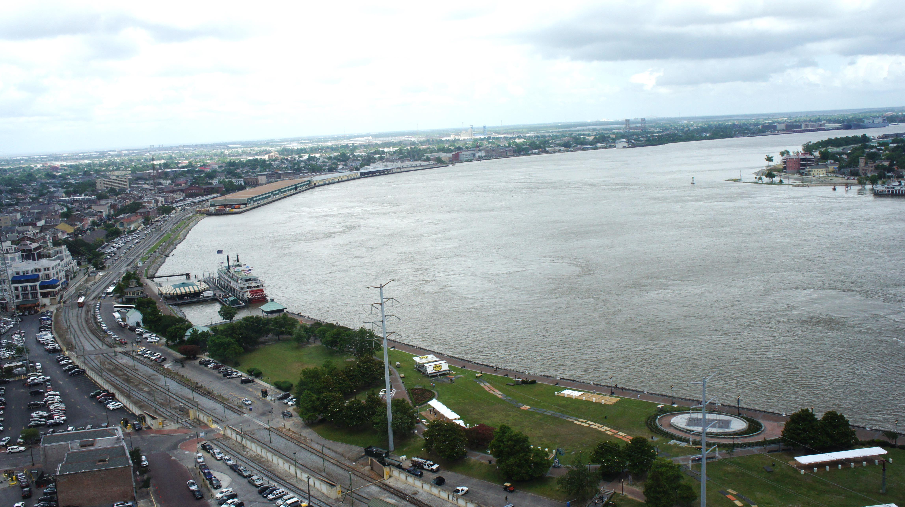

Climate Adaptation and Disaster Risk Reduction: Freshwater Examples at a Global Scale
Frank Lowenstein

Slide 2

FW climate challenges
Climate change is now
Variability and Extremes
Synergies
More intense precipitation
Increasingly arid conditions

Slide 3
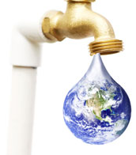
What are we trying to achieve in the Global Freshwater Team?
“Water security for people and nature through the integration of natural and human infrastructure in water resource management and water services”

Slide 4
Opportunity map Services Green interventions
River operations (hydro, transport)
Masterplanning & Siting
Re-operation
Water security for people and nature through the integration of natural and human infrastructure in water resource management and water services
Floodplain reconnection and management
Catchment restoration
Flood management)
Irrigation
Agricultural efficiency
Wetland/ditch mgmt
Water for energy infrastructure, industry & technology
Corporate practices: watershed stewardship
Clean water supply
Catchment protection
Water rights purchase
Waste water removal and stormwater flooding
Green infra for flood and storm water

Slide 5
TNC’s reach from local initiatives to scaling global strategies
PRELIMINARY
ILLUSTRATIVE
North America
Latin America
Asia
Africa
Floodplain reconnection and management
Mississippi River
+ North America RRR plan
Magdalena
Yangtze
Catchment restoration and management
Chiapas watersheds
Corporate practices: watershed stewardship (eg bD)
Reinsurance industry engagement
Engineering firms?
Indonesia
Small Island States
USA
Colombia and Mexico
China
Notes:
Change outcomes to reflect CDRR outcomes

Slide 6
How do we achieve global scale?
Impact through
Partners
$1-2 billion
Global impact at scale
$50-100 billion
Direct impact
TNC
$50-100 million

Slide 7
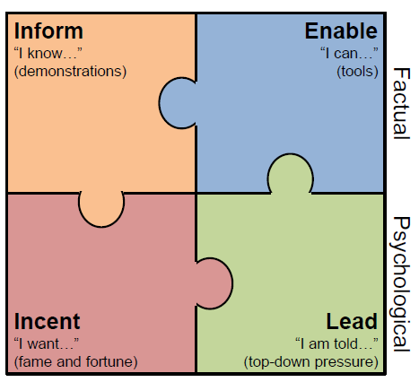
Our theory of change – how to scale through others
All four need to be in place to make change happen

Slide 8
Frank’s cliff notes to the IEIL framework
Inform– show it can be done
Enable– help others do it
Incentivize– drive funding and policy to make it easier to do it
Lead—build political will and social expectation so that others will do it

Slide 9
Audiences
Policy:
  UNFCCC, UNISDR
  World Bank, GEF, other multinationals,
  national governments
  state governments in key areas
Corporate:
  Engineering firms,
  Reinsurance industry
Urban leaders

Slide 10
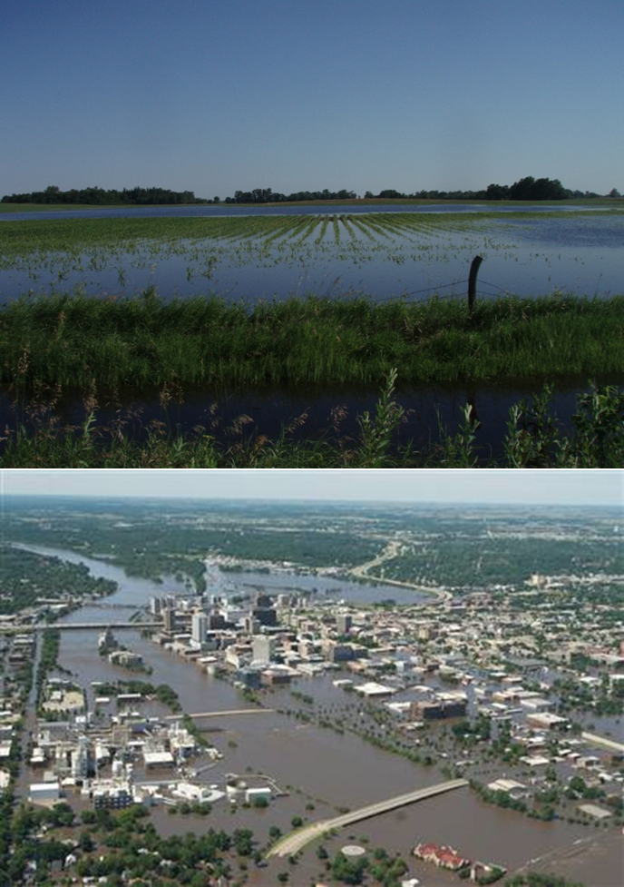
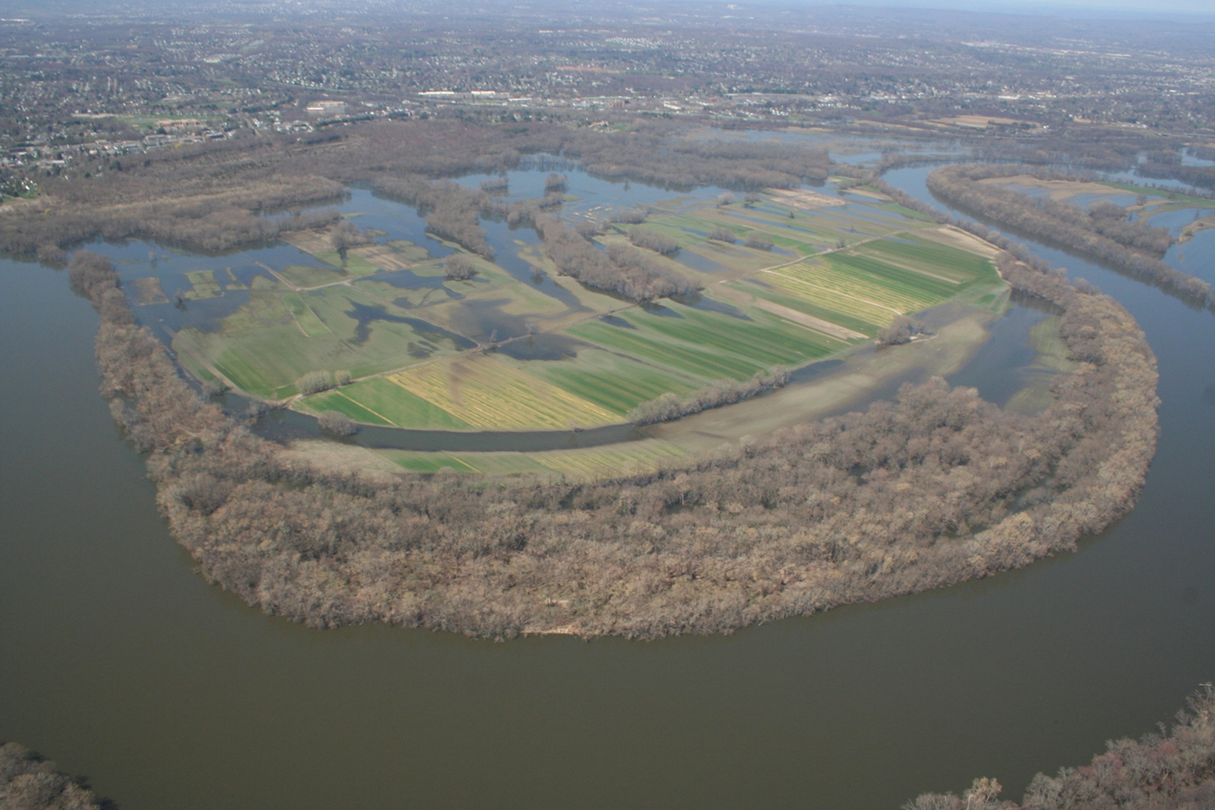
Floodplains

Slide 11
Inform– quantifying the role of floodplains in reducing flood magnitudes and damages
Enable– climate wizard, linked hydrologic- climate models, documenting the economic case for floodplain restoration
Incentivize– impact capital, FEMA reform, influencing key actors in Mexico, Colombia, China
Lead– reinsurance engagement

Slide 12
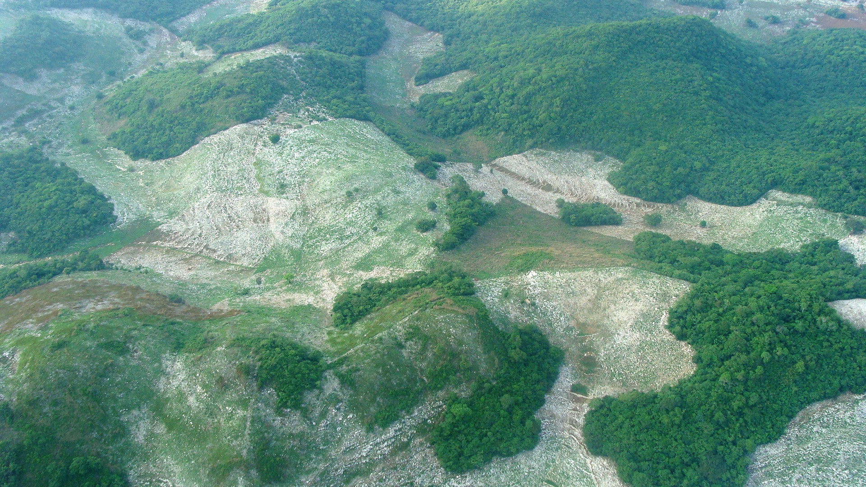
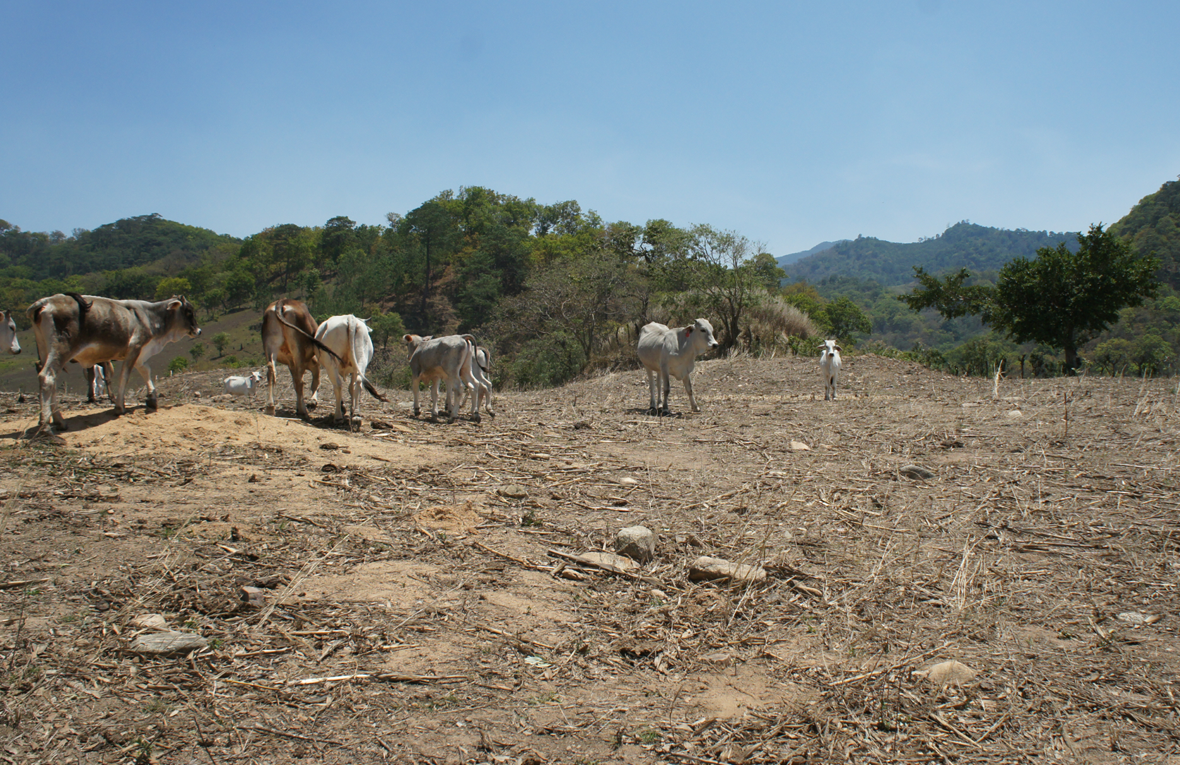
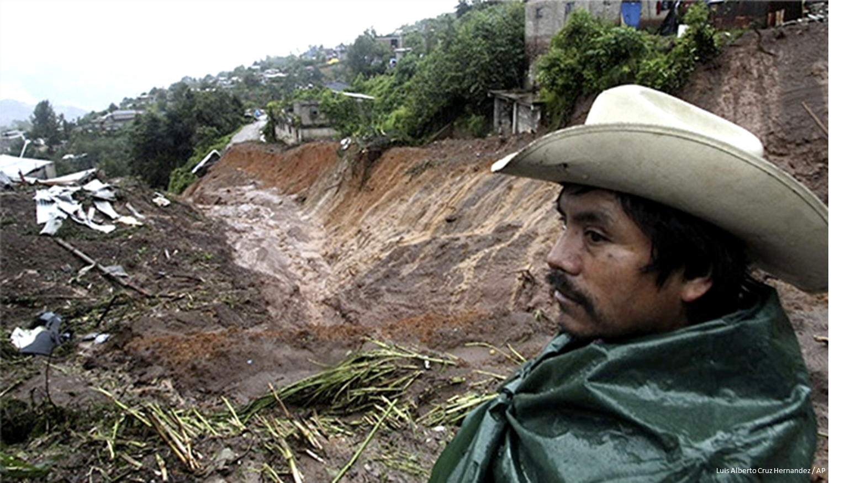
Watershed restoration

Slide 13
Inform– document watershed and regional level successes (Chiapas, Southwest US)
Enable–Climate wizard, climate Adaptation Learning Network, farmer to farmer learning
Incentivize– Water fund financing mechanism, state and federal policy in Mexico
Lead– report on climate adaptation and water for C40

Slide 14
Some principles of operation (per Giulio Boccaletti)
We should be ideas rich and resource constrained!
We should strive to be a practice that delivers more than the sum of the parts, across local offices, region, and global
We should describe each component of a global program as either a project, a product, a message
In all cases, we must be able to describe each initiative as something someone does to achieve a specific impact that someone is willing to pay for
We must be able to describe how the world will be different because we have been here

Slide 15
THANK YOU
Jeff DeBlieu, Jim Rieger, Jeff Opperman, Mark Smith, Evan Girvetz, Kris Johnson, Rosario Gomez, Bob Carey, Juliana Delgado, Julio Carcamo, Giulio Boccaletti, Olivia Millard and especially Lisa Shipley!

